Slide 1



Do not edit
How to change the design
Join at slido.com #4345678
Presenting with animations, GIFs or speaker notes? Enable our Chrome extension
Notes:
📣 This is Slido interaction slide, please don't delete it. ✅ Click on 'Present with Slido' and the joining instructions will appear when you get to this slide.

Slide 2

Do not edit
How to change the design
What are the use case of serverless computing?
Presenting with animations, GIFs or speaker notes? Enable our Chrome extension
Notes:
📣 This is Slido interaction slide, please don't delete it. ✅ Click on 'Present with Slido' and the poll will launch automatically when you get to this slide.

Slide 3
Monitoring & Logging in AWS (CloudWatch, CloudTrail, Logging)
Understanding application behavior and performance

Slide 4

Introduction to AWS CloudFormation
AWS CloudFormation allows you to model and provision AWS resources using Infrastructure as Code (IaC).
Automates the creation and management of AWS resources.
Supports YAML and JSON templates.

Slide 5

Do not edit
How to change the design
What is the primary purpose of AWS CloudFormation?
Presenting with animations, GIFs or speaker notes? Enable our Chrome extension
Notes:
📣 This is Slido interaction slide, please don't delete it. ✅ Click on 'Present with Slido' and the poll will launch automatically when you get to this slide.

Slide 6
Key Features of AWS CloudFormation
Template-driven resource management.
Supports rollback on failure.
Stack creation, update, and deletion.
Integrates with CI/CD pipelines.

Slide 7
Do not edit
How to change the design
Which feature allows AWS CloudFormation to revert changes when stack creation fails?
Presenting with animations, GIFs or speaker notes? Enable our Chrome extension
Notes:
📣 This is Slido interaction slide, please don't delete it. ✅ Click on 'Present with Slido' and the poll will launch automatically when you get to this slide.

Slide 8
CloudFormation Stacks and Templates
Stack: Collection of AWS resources managed as a single unit.
Template: JSON or YAML file defining AWS resources and configurations.
Parameters, resources, mappings, outputs, and conditions are key template components.

Slide 9
Do not edit
How to change the design
What is an AWS CloudFormation stack?
Presenting with animations, GIFs or speaker notes? Enable our Chrome extension
Notes:
📣 This is Slido interaction slide, please don't delete it. ✅ Click on 'Present with Slido' and the poll will launch automatically when you get to this slide.

Slide 10


Introduction to Monitoring & Logging in AWS
Monitoring and logging are essential for understanding application behavior and performance in the cloud.
AWS provides services like CloudWatch, CloudTrail, and various logging options for complete visibility.

Slide 11
Do not edit
How to change the design
Which AWS services are primarily used for monitoring and logging?
Presenting with animations, GIFs or speaker notes? Enable our Chrome extension
Notes:
📣 This is Slido interaction slide, please don't delete it. ✅ Click on 'Present with Slido' and the poll will launch automatically when you get to this slide.

Slide 12
Introduction to Amazon CloudWatch
CloudWatch provides monitoring for AWS resources and applications.
Key features: metrics collection, logs, dashboards, and alarms.
Enables real-time observability and operational insights.

Slide 13
Do not edit
How to change the design
What is a key feature of Amazon CloudWatch?
Presenting with animations, GIFs or speaker notes? Enable our Chrome extension
Notes:
📣 This is Slido interaction slide, please don't delete it. ✅ Click on 'Present with Slido' and the poll will launch automatically when you get to this slide.

Slide 14
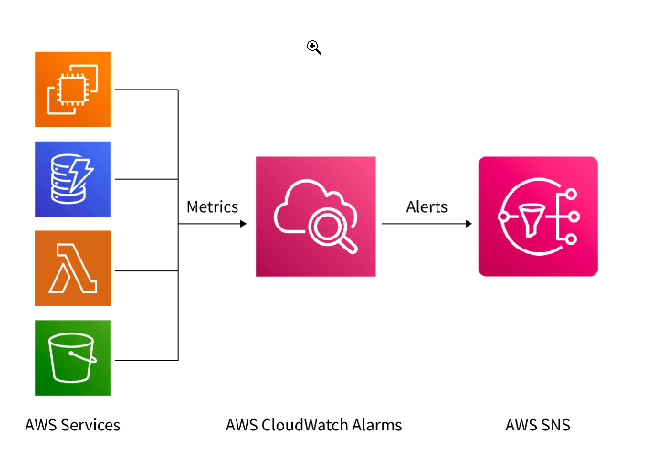

Slide 15
CloudWatch Logs and Metrics
CloudWatch Logs: Store, monitor, and access log files from AWS services and applications.
CloudWatch Metrics: Provide performance data for AWS resources.
Supports real-time application and infrastructure insights.

Slide 16
Do not edit
How to change the design
Which component of CloudWatch stores log files?
Presenting with animations, GIFs or speaker notes? Enable our Chrome extension
Notes:
📣 This is Slido interaction slide, please don't delete it. ✅ Click on 'Present with Slido' and the poll will launch automatically when you get to this slide.

Slide 17
Introduction to AWS CloudTrail
CloudTrail records AWS API calls for account activity.
Provides event history for auditing and compliance.
Integrates with CloudWatch for real-time monitoring.

Slide 18
Do not edit
How to change the design
Which AWS service records API call history for auditing purposes?
Presenting with animations, GIFs or speaker notes? Enable our Chrome extension
Notes:
📣 This is Slido interaction slide, please don't delete it. ✅ Click on 'Present with Slido' and the poll will launch automatically when you get to this slide.

Slide 19
CloudTrail Event Categories
Management Events: Track control plane operations (e.g., creating resources).
Data Events: Provide insights into data plane operations (e.g., S3 object access).
Insight Events: Detect unusual operational activities.

Slide 20
Do not edit
How to change the design
Which CloudTrail event category tracks S3 object access?
Presenting with animations, GIFs or speaker notes? Enable our Chrome extension
Notes:
📣 This is Slido interaction slide, please don't delete it. ✅ Click on 'Present with Slido' and the poll will launch automatically when you get to this slide.

Slide 21
Logging Best Practices
Enable multi-region CloudTrail for comprehensive tracking.
Use CloudWatch Alarms to detect anomalies.
Centralize logs using S3 and analyze with AWS Athena.
Regularly review logs for security and operational health.

Slide 22
Do not edit
How to change the design
Which AWS service is commonly used to store centralized logs?
Presenting with animations, GIFs or speaker notes? Enable our Chrome extension
Notes:
📣 This is Slido interaction slide, please don't delete it. ✅ Click on 'Present with Slido' and the poll will launch automatically when you get to this slide.

Slide 23
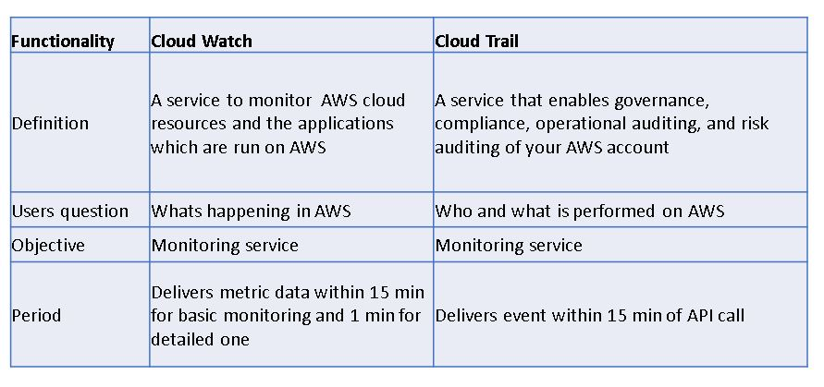

Slide 24
Question 1:
A company wants to track all API activities across multiple AWS regions for security auditing. Which AWS service and configuration would you recommend?

Slide 25
Question 1:
A company wants to track all API activities across multiple AWS regions for security auditing. Which AWS service and configuration would you recommend?
Use AWS CloudTrail with multi-region trails to record all API activities.
Store logs in Amazon S3 for durability and use AWS Athena for querying.

Slide 26
Question 2:
Your application experiences performance issues during peak hours. How can you monitor and troubleshoot the root cause using AWS services?

Slide 27
Question 2:
Your application experiences performance issues during peak hours. How can you monitor and troubleshoot the root cause using AWS services?
Utilize Amazon CloudWatch to set up dashboards for real-time metrics.
Analyze CloudWatch Logs for application errors.
Set CloudWatch Alarms to trigger notifications for performance anomalies.

Slide 28
Q3
A client needs to detect unusual API activities that might indicate a security threat. What AWS service and feature would you suggest?

Slide 29
Q3
A client needs to detect unusual API activities that might indicate a security threat. What AWS service and feature would you suggest?
Recommend AWS CloudTrail Insights, which automatically detects unusual patterns in API activity.
Integrate with Amazon CloudWatch for real-time alerts.

Slide 30

Do not edit
How to change the design
Audience Q&A
Presenting with animations, GIFs or speaker notes? Enable our Chrome extension
Notes:
📣 This is Slido interaction slide, please don't delete it. ✅ Click on 'Present with Slido' and the questions from your audience will appear when you get to this slide.

